Slide 1

MACHINE LEARNING FOR CROP RECOMMENDATION PURPOSE IN AGRICULTURE
PRESENTED BY
POLOJU LAXMANKUMAR
MALLA REDDY INSTITUTE OF TECHNOLOGY AND SCIENCE
COMPUTER SCIENCE AND ENGINEERING

Slide 2


ABSTRACT
The abstract begins by acknowledging the significance of agriculture in India and the central role of farmers in the agricultural sector. It highlights the socioeconomic challenges faced by Indian farmers and the difficulty in crop selection due to the variation in soil types across regions..
Thus, it introduces a novel approach to address the challenges of crop selection through the development of a crop recommendation system. This system utilizes advanced machine learning techniques, specifically a Convolutional Neural Network (CNN) and a Random Forest Model, to predict the optimal crop based on various parameters including region, soil type, yield, and selling price.
The methodology employed in the crop recommendation system, detailing the use of CNN architecture and Random Forest Algorithm for accurate prediction. It emphasizes the importance of analyzing multiple parameters to ensure precise recommendations.

Slide 3
EXISTING SYSTEM
Due to the revolution in industrialization, the economic contribution of agriculture to India’s GDP is steadily declining with the country’s broad-based economic growth.
The problem that the Indian Agriculture sector is facing is the integration of technology to bring the desired outputs.
With the advent of new technologies and overuse of non-renewable energy resources patterns of rainfall and temperature are disturbed.
The inconsistent trends developed from the side effects of global warming make it cumbersome for the farmers to clearly predict the temperature and rainfall patterns thus affecting their crop yield productivity.
In order to perform accurate prediction and handle inconsistent trends in temperature and rainfall various machine learning algorithms like RNN, LSTM, etc can be applied to get a pattern.

Slide 4
DISADVANTAGES OF EXISTING SYSTEM
One of the main challenges faced by the current system is the lack of knowledge about changing variations in climate, which are crucial for determining suitable climatic conditions for different crops
The existing system for recommending crop yield is either hardware-based, making it costly to maintain, or not easily accessible to all farmers, hindering widespread adoption
Despite recent proposals for solutions, there are still open challenges in creating a user-friendly application for crop recommendation, indicating a need for more accessible and intuitive systems
Existing techniques are criticized for being time-consuming and providing inaccurate outputs of crop production datasets, highlighting limitations in efficiency and accuracy

Slide 5
Literature Survey:
PREDICTING YIELD OF THE CROP USING MACHINE LEARNING ALGORITHM
AUTHORS: P.Priya, U.Muthaiah & M.Balamurugan
The agriculture plays a dominant role in the growth of the country’s economy.Climate and other environmental changes has become a major threat in the agriculture field. Machine learning (ML) is an essential approach for achieving practical and effective solutions for this problem.
Applications of machine learning techniques in agricultural crop production: a review
AUTHORS: Mishra .s, Mishra .D and Santra .G. H
This paper has been prepared as an effort to reassess the research studies on the relevance of machine learning techniques in the domain of agricultural crop production. Methods/Statistical Analysis: This method is a new approach for production of agricultural crop management. Accurate and timely forecasts of crop production are necessary for important policy decisions like import-export, pricing marketing distribution etc.

Slide 6
Literature Survey:
Agricultural crop yield prediction using artificial neural network approach
AUTHORS: Dahikar, S. S, Rode and S. V.
By considering various situations of climatologically phenomena affecting local weather conditions in various parts of the world. These weather conditions have a direct effect on crop yield. Various researches have been done exploring the connections between large-scale climatologically phenomena and crop yield. Artificial neural networks have been demonstrated to be powerful tools for modeling and prediction, to increase their effectiveness.
Predictive ability of machine learning methods for massive crop yield prediction.
AUTHORS: Gonzlez Snchez. A, Frausto Sols. J and Ojeda Bustamante. W
An important issue for agricultural planning purposes is the accurate yield estimation for the numerous crops involved in the planning. Machine learning (ML) is an essential approach for achieving practical and effective solutions for this problem. Many comparisons of ML methods for yield prediction have been made, seeking for the most accurate technique. Generally, the number of evaluated crops and techniques is too low and does not provide enough information for agricultural planning purposes.

Slide 7
PROPOSED SYSYTEM
This paper focuses on the practical application of machine learning algorithms and its quantification.
The work presented here also takes into account the inconsistent data from rainfall and temperature datasets to get a consistent trend.
Crop yield prediction is determined by considering all the features in contrast with the usual trend of determining the prediction considering one feature at a time.

Slide 8
ADVANTAGES OF PROPOSED SYSTEM
The system provides personalized crop recommendations based on soil characteristics, climate conditions, historical yields, and farmer preferences, empowering farmers with tailored insights for optimal crop selection
By integrating advanced technologies like machine learning and data analytics, the system offers a comprehensive approach to crop selection, considering factors such as soil properties, climate conditions, and farmer preferences
The model incorporates explainable artificial intelligence (XAI) to transparently present the reasoning behind specific crop recommendations, enhancing communication between advisors and farmers
It predicts crop yield by analyzing factors like rainfall, temperature, PH and humidity, aiding farmers in maximizing crop yield and meeting the increasing demand for food production

Slide 9
PROPOSED SYSTEM ALGORITHM
Let the number of training cases be N, and the number of variables in the classifier be M.
The number m of input variables are used to determine the decision at a node of the tree; m should be much less than M.
Choose a training set for this tree by choosing N times with replacement from all N available training cases. Use the rest of the cases to estimate the error of the tree, by predicting their classes.
For each node of the tree, randomly choose m variables on which to base the decision at that node. Calculate the best split based on these m variables in the training set.
Each tree is fully grown and not pruned.

Slide 10
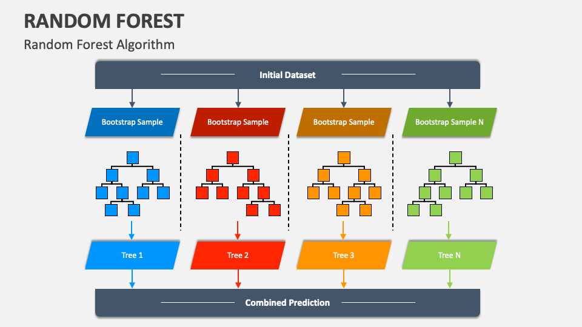
RAMDOM FOREST ALGORITHM

Slide 11
OPERATION OF RANDOM FOREST
The working of random forest algorithm is as follows.
A random seed is chosen which pulls out at random a collection of samples from the training dataset while maintaining the class distribution.
With this selected data set, a random set of attributes from the original data set is chosen based on user defined values. All the input variables are not considered because of enormous computation and high chances of over fitting.
In a dataset where M is the total number of input attributes in the dataset, only R attributes are chosen at random for each tree where R< M.
The attributes from this set creates the best possible split using the gini index to develop a decision tree model. The process repeats for each of the branches until the termination condition stating that leaves are the nodes that are too small to split.

Slide 12

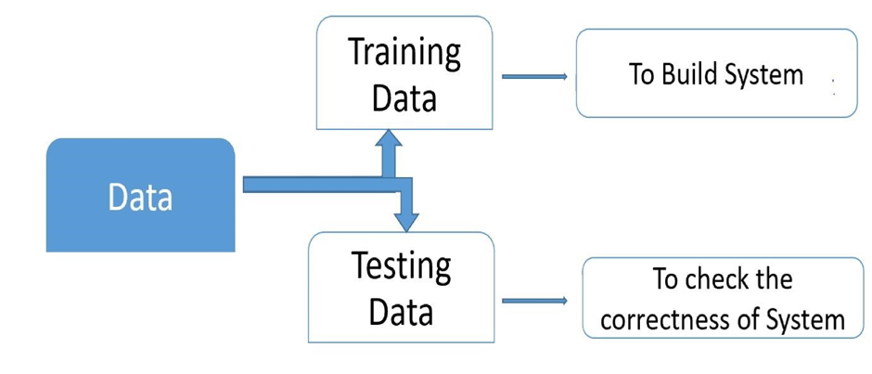
OPERATION OF RANDOM FOREST
SYSTEM ARCHITECTURE

Slide 13
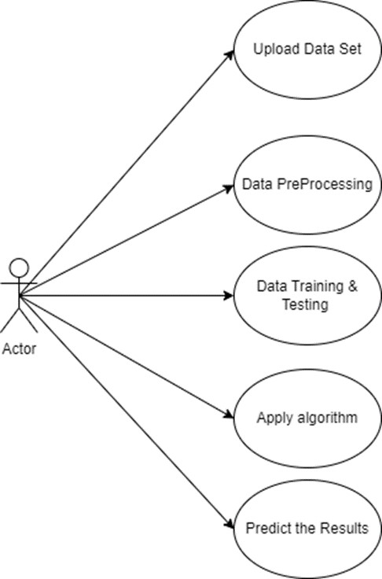
UML DIAGRAMS

Slide 14
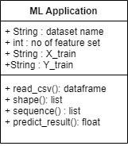
UML DIAGRAM

Slide 15
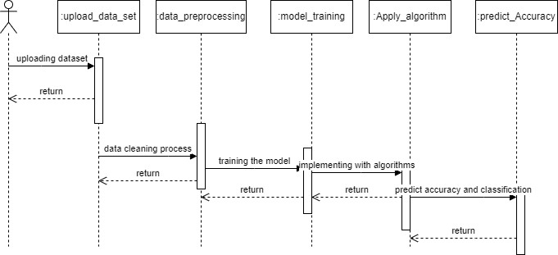
UML DIAGRAM

Slide 16
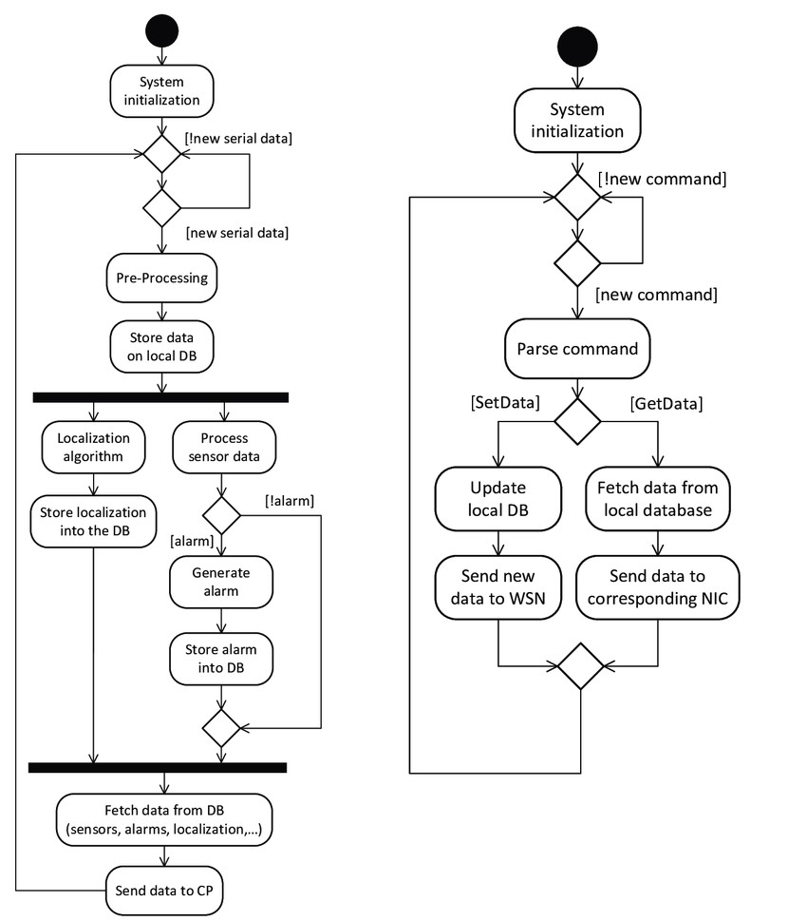
UML DIAGRAM
ACTIVITY DIAGRAM:

Slide 17
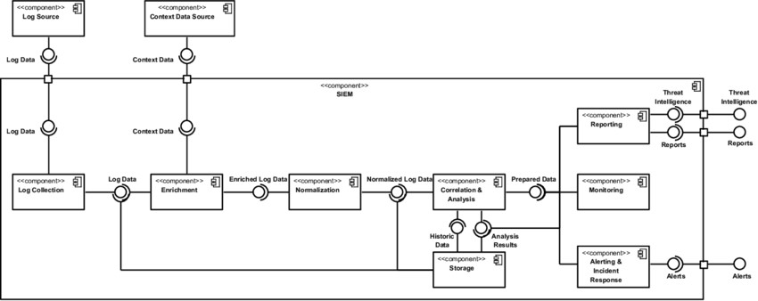
UML DIAGRAM
COMPONENT DIAGRAM:

Slide 18
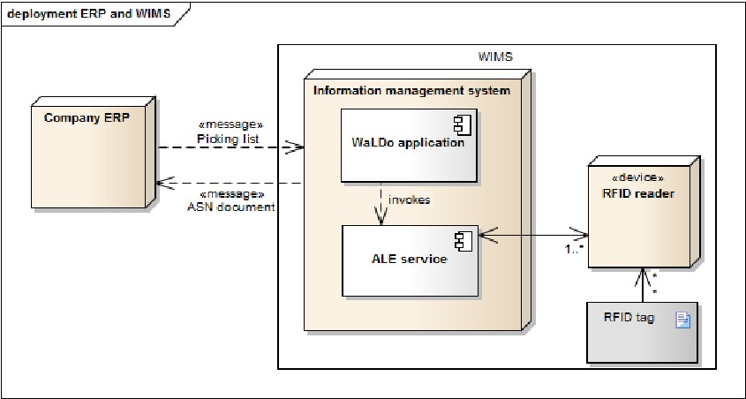
UML DIAGRAM
DEPLOYMENT DIAGRAM:

Slide 19
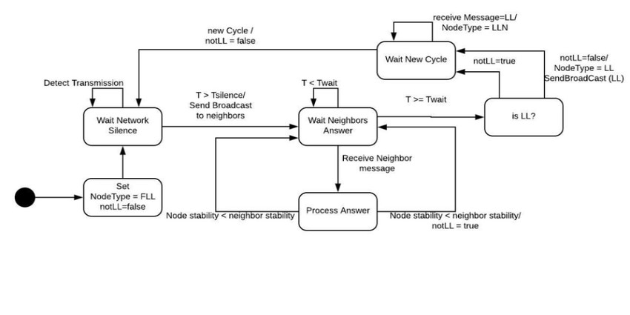
UML DIAGRAM
STATE DIAGRAM:

Slide 20
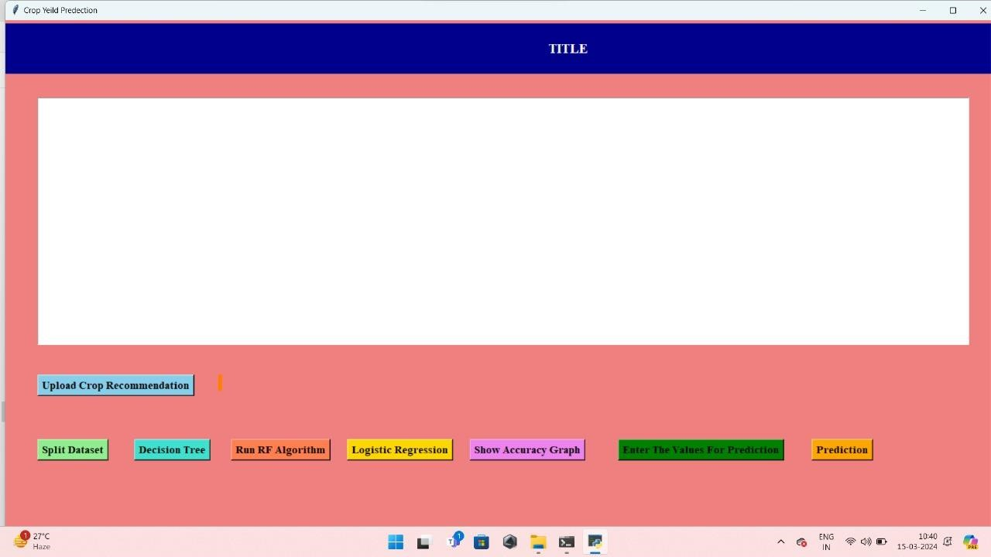
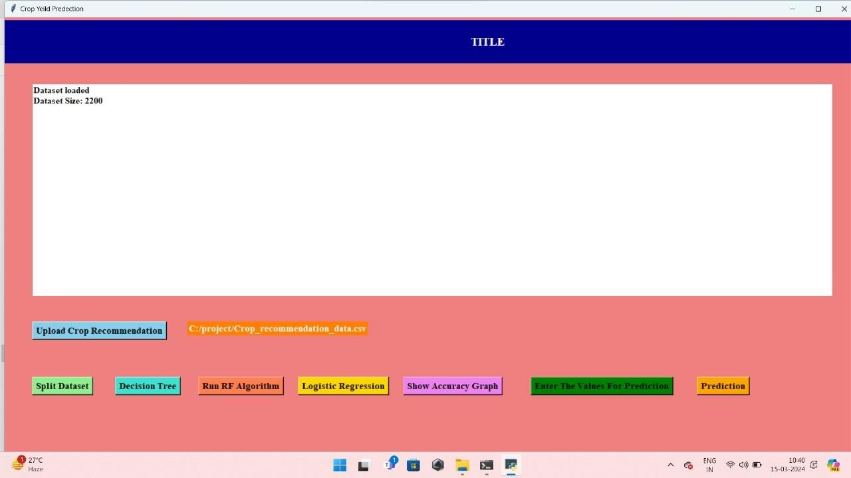
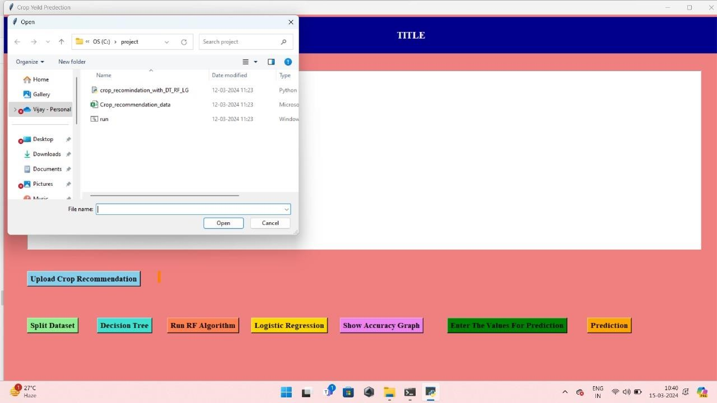
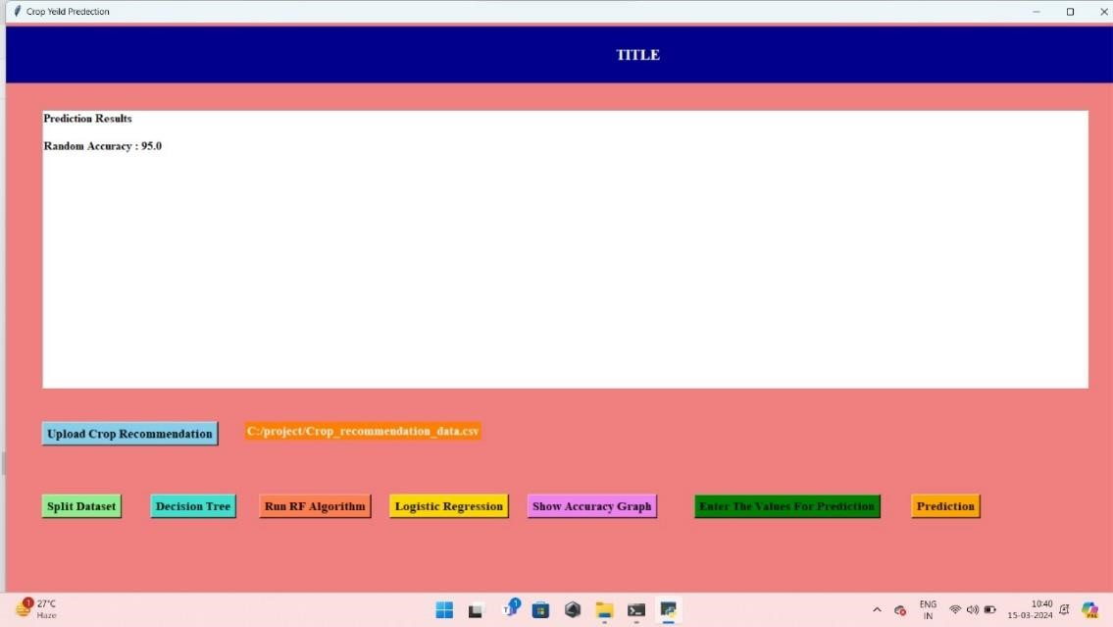
RESULTS

Slide 21
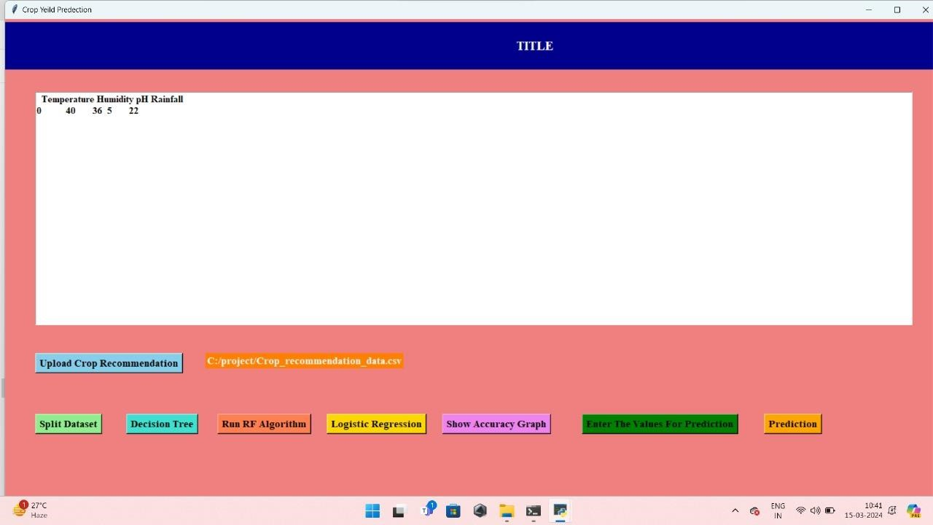
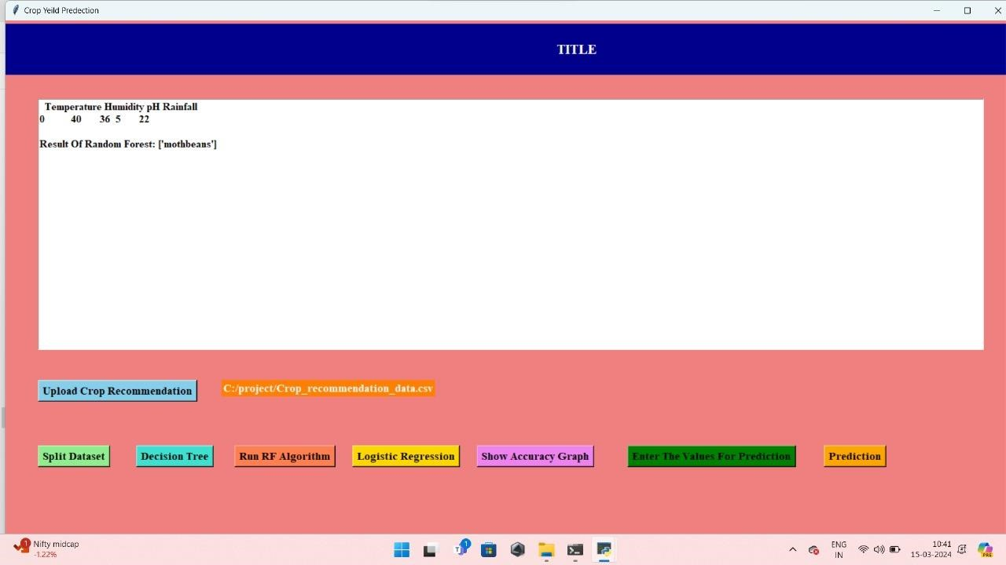
RESULTS

Slide 22
SYSTEM TEST
THANK YOU

